Slide 1
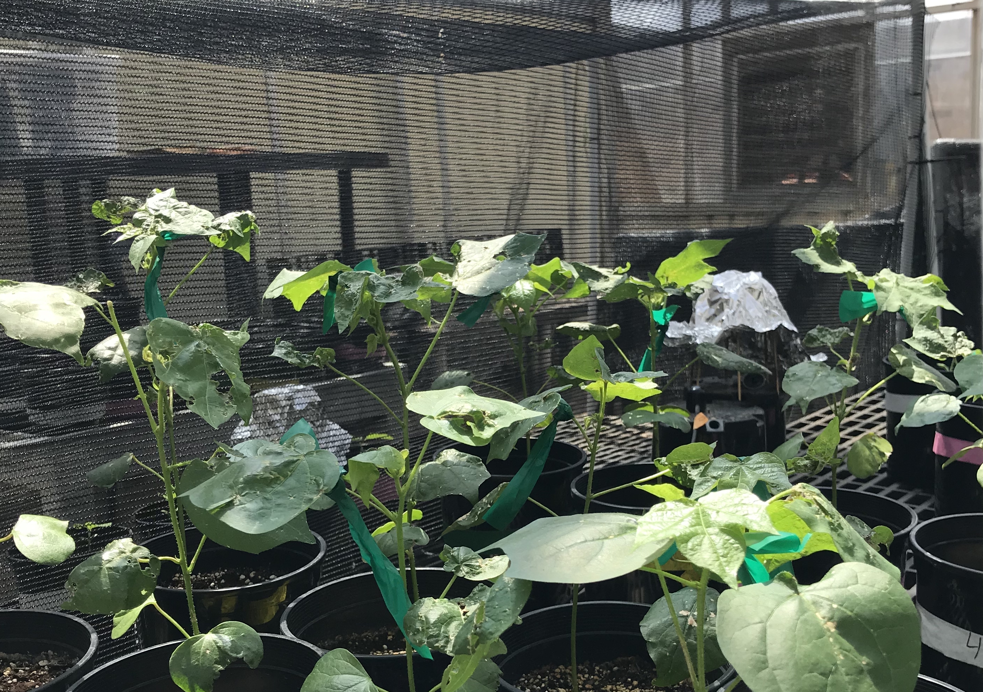
Inoculation status and soil nitrogen fertilization modifies carbon costs to acquire nitrogen in Glycine max L.: implications for water-nitrogen economics and nutrient allocation strategies in nitrogen-fixing species
1

Slide 2

Plant nitrogen acquisition is a process in terrestrial systems where carbon and nitrogen are tightly coupled
CO₂
2
Schematic adapted from Brzostek et al. (2014) JGR Biogeosciences
Notes:
This is an overly simplistic schematic that I hope will demonstrate this
Plants draw carbon dioxide in from the atmosphere and convert this to simple sugars

Slide 3
Plant nitrogen acquisition is a process in terrestrial systems where carbon and nitrogen are tightly coupled
CO₂
NPP, growth
3
Schematic adapted from Brzostek et al. (2014) JGR Biogeosciences
Notes:
This supports net primary production, and allows plants to allocate carbon toward two primary pathways

Slide 4
Plant nitrogen acquisition is a process in terrestrial systems where carbon and nitrogen are tightly coupled
CO₂
NPP, growth
C_{transfer}
C_{growth}
4
Schematic adapted from Brzostek et al. (2014) JGR Biogeosciences
Notes:
First, plants might use carbon to support whole plant growth. This may be through woody tissue production, leaf production and maintenance, or toward storage
Alternatively, plants might use carbon to support soil resource uptake. This can either be through fine root production, root exudation, or carbon exchange with microbial symbionts

Slide 5
Plant nitrogen acquisition is a process in terrestrial systems where carbon and nitrogen are tightly coupled
CO₂
NPP, growth
C_{transfer}
C_{growth}
N_{growth}
N_{available}
5
Schematic adapted from Brzostek et al. (2014) JGR Biogeosciences
Notes:
Plants use carbon allocated belowground to acquire important resources that support photosynthetic and metabolic demand. While there are a ton of different nutrients plants acquire, plants acquire nitrogen in the largest quantity.
Once acquired, nitrogen can be used for maintenance of structural tissue, production and maintenance of photosynthetic enzymes, and many other important functions that are critical for the growth, reproduction, and survival of an individual plant.

Slide 6
Plant nitrogen acquisition is a process in terrestrial systems where carbon and nitrogen are tightly coupled
CO₂
There are inherent carbon costs associated with acquiring nitrogen
NPP, growth
C_{transfer}
C_{growth}
N_{growth}
N_{available}
6
Schematic adapted from Brzostek et al. (2014) JGR Biogeosciences
Notes:
However, plants are not able to acquire nitrogen without first allocating carbon belowground.
Thus, there are inherent carbon costs associated with acquiring nitrogen.
These can include structural carbon costs associated with root production and maintenance, or active carbon costs associated with exchange of carbon to microbial symbionts.

Slide 7
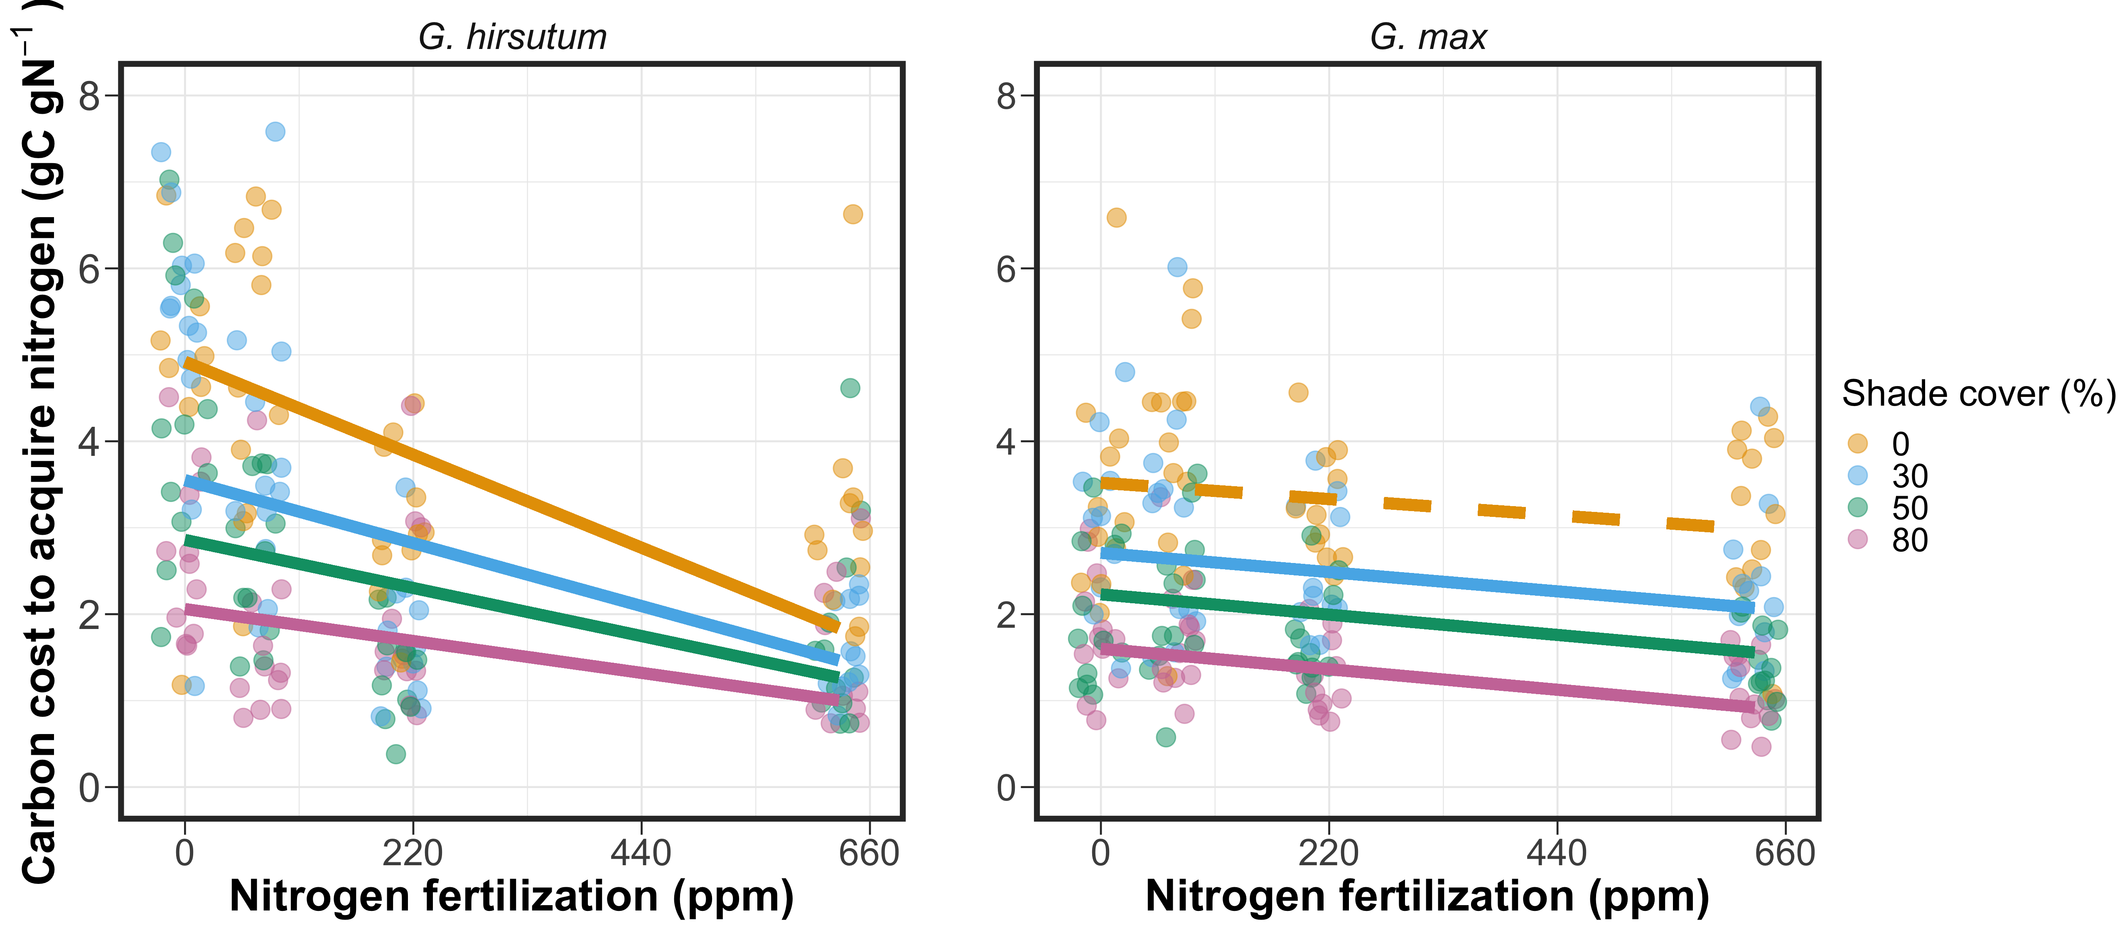
Soil nitrogen availability may decrease carbon costs to acquire nitrogen as a function of increased per-root nitrogen uptake
Brzostek et al. (2014) JGR Biogeosciences
Notes:
Importantly, carbon costs to acquire nitrogen are dynamic and therefore are likely to change with changing aboveground and belowground environmental conditions.
Belowground, soil nitrogen availability likely plays an important role in modifying these carbon costs.
This is because increases in soil nitrogen availability do not influence plant demand to acquire soil resources, and therefore likely do not have a large impact on the magnitude of belowground carbon investments.
Thus, if plants acquire additional nitrogen without a proportional change in belowground carbon, then carbon costs to acquire nitrogen would likely decrease with increasing soil nitrogen availability.
This could be indexed through increased per-root nitrogen uptake in species that acquire most of their nitrogen through direct uptake

Slide 8
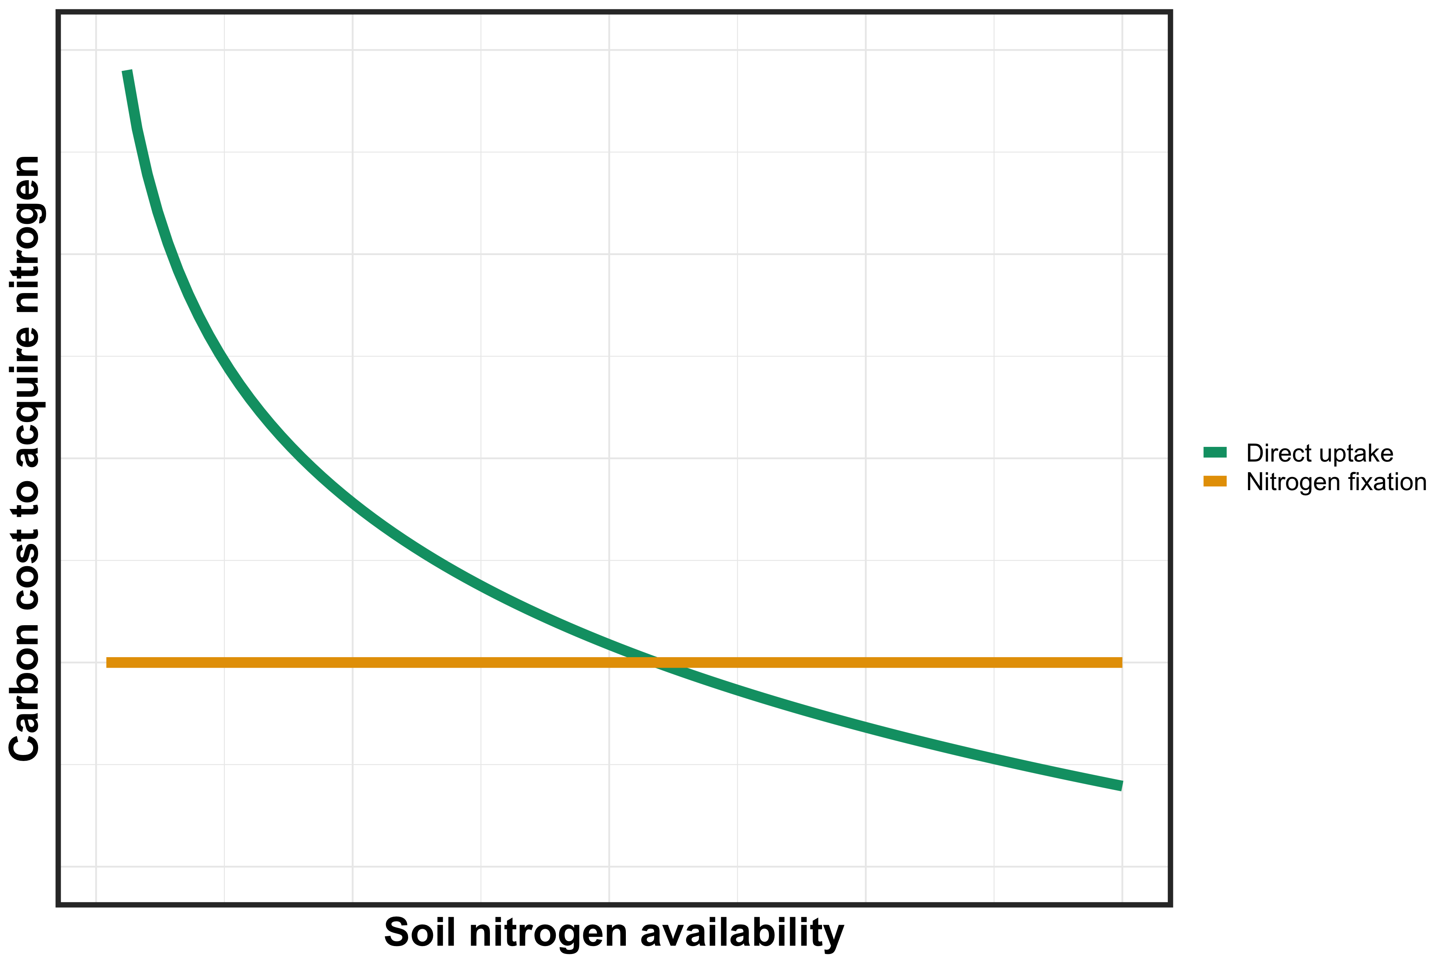
However, effects of soil nitrogen availability on carbon costs to acquire nitrogen may be context dependent on species nitrogen acquisition strategy
8
Notes:
It is important to note, however, that effects of soil nitrogen availability on carbon costs to acquire nitrogen may be context dependent on species nitrogen acquisition strategy.
This has been shown in several modeling studies and meta-analyses in species that associate with different types of mycorrhizal fungi, species that associate with nitrogen fixing bacteria, and species that acquire nitrogen mostly via direct uptake
This figure describes the hypothesized relationship between soil nitrogen availability, represented on the x-axis, and carbon costs to acquire nitrogen, represented on the y-axis between two nitrogen acquisition strategies

Slide 9
However, effects of soil nitrogen availability on carbon costs to acquire nitrogen may be context dependent on species nitrogen acquisition strategy
9
Notes:
Species that associate with nitrogen-fixing bacteria are represented by a yellow trendline and species that acquire nitrogen via direct uptake are represented by a green trendline

Slide 10
However, effects of soil nitrogen availability on carbon costs to acquire nitrogen may be context dependent on species nitrogen acquisition strategy
10
Notes:
You can see that species that associate with nitrogen-fixing bacteria have lower carbon costs to acquire nitrogen than species that acquire nitrogen via direct uptake when soil nitrogen is less available.
This may pose a competitive advantage to species that associate with nitrogen fixing bacteria, as species would be able to acquire more nitrogen from a carbon investment
However, as soil nitrogen availability increases, species that acquire nitrogen via direct uptake experience decreased carbon costs to acquire nitrogen, likely as a function of increased per-root nitrogen uptake.
Eventually, this may lead to a scenario where it is more advantageous for species to acquire nitrogen from direct uptake pathways than through nitrogen fixation, and could cause nitrogen-fixing species to switch away from nitrogen fixation to direct uptake to maximize nitrogen uptake from a belowground carbon investment

Slide 11
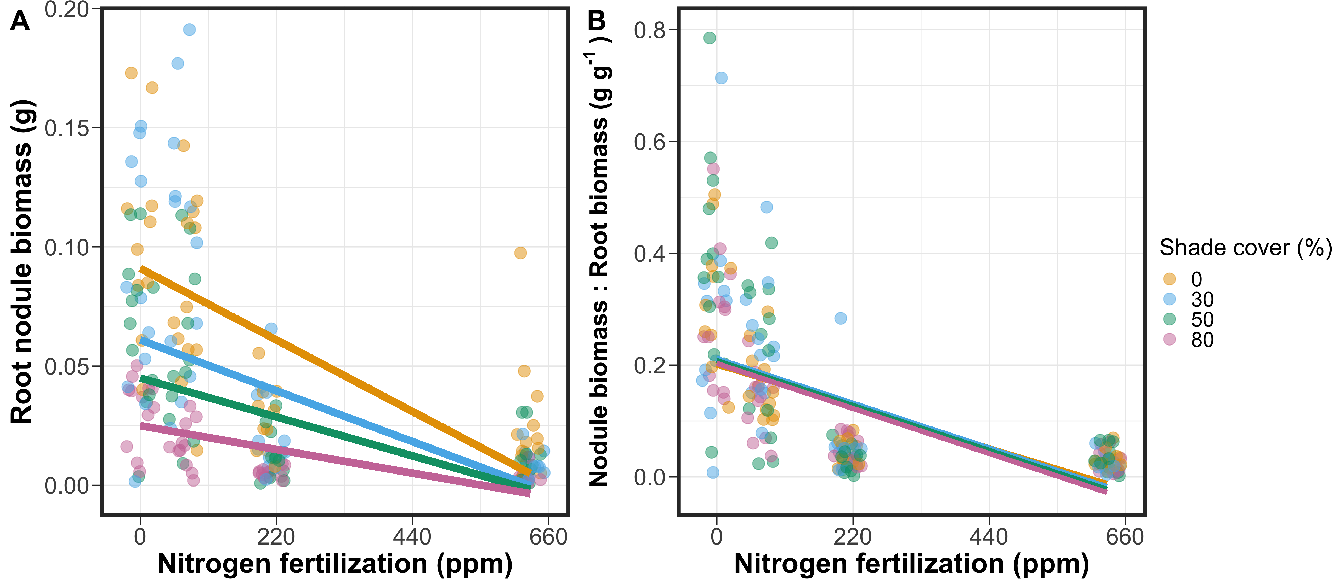
Increasing soil nitrogen availability should reduce nitrogen acquisition via nitrogen fixation due to a shift toward direct uptake

Slide 12
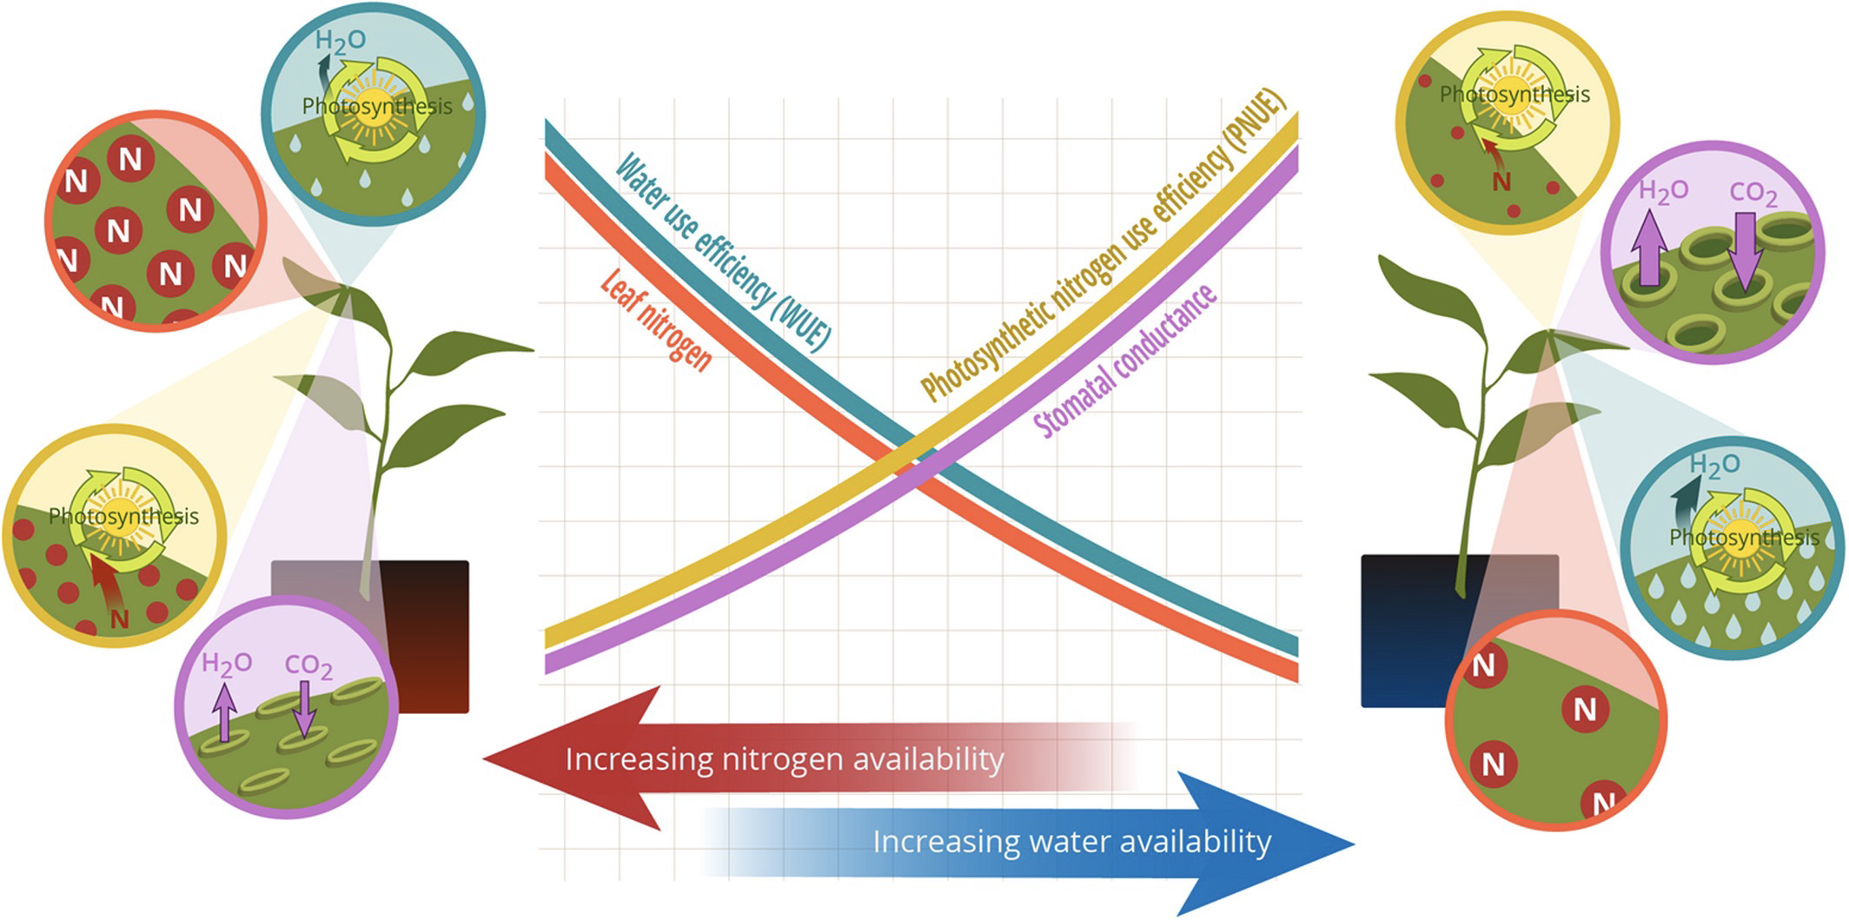
Shifts in carbon costs to acquire nitrogen may result in alterations in plant nutrient allocation strategies
Decreasing N_{cost}
Bialic-Murphy et al. (2021) Ecol. Letters

Slide 13
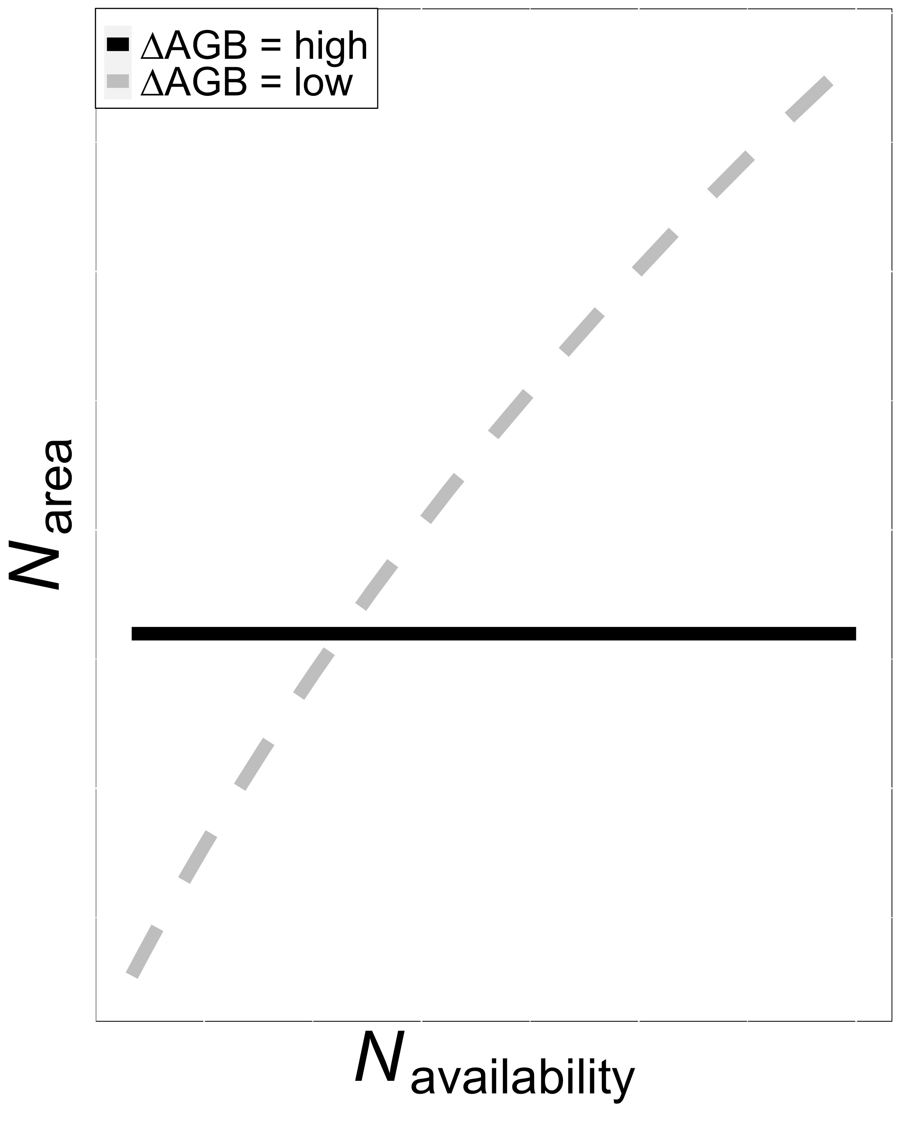
Shifts in carbon costs to acquire nitrogen may result in alterations in plant nutrient allocation strategies
Decreasing N_{cost}
Smith et al. (in prep)

Slide 14
Research Questions
How does nitrogen fixation and soil nitrogen availability influence plant carbon costs to acquire nitrogen?
Notes:
In the context of potential sources of variation in carbon costs to acquire nitrogen, we were interested in understanding how soil nitrogen availability and light availability influenced plant carbon costs to acquire nitrogen

Slide 15
Research Questions
How does nitrogen fixation and soil nitrogen availability influence plant carbon costs to acquire nitrogen?
Do plant carbon costs to acquire nitrogen modify tradeoffs between leaf nitrogen and water usage?
Notes:
In the context of potential sources of variation in carbon costs to acquire nitrogen, we were interested in understanding how soil nitrogen availability and light availability influenced plant carbon costs to acquire nitrogen

Slide 16
Research Questions
How does nitrogen fixation and soil nitrogen availability influence plant carbon costs to acquire nitrogen?
Do plant carbon costs to acquire nitrogen modify tradeoffs between leaf nitrogen and water usage?
Do plant carbon costs to acquire nitrogen modify tradeoffs between leaf nitrogen allocation and whole plant growth?
Notes:
In the context of potential sources of variation in carbon costs to acquire nitrogen, we were interested in understanding how soil nitrogen availability and light availability influenced plant carbon costs to acquire nitrogen

Slide 17
Experimental setup
16 replicates per treatment combination
x
Soil fertilization
Inoculation with
B. japonicum
70 ppm N
+ BNF
630 ppm N
- BNF
A/C_{i} curves and dark respiration measurements completed ~5-6 weeks after experiment initiation
Destructive harvest of focal leaves immediately following curves
Destructive harvest of all organs ~1 week after photosynthetic measurements
Notes:
We set up a greenhouse experiment where we grew G. max under two soil nitrogen levels and manipulated inoculation status in a full factorial, random block design.

Slide 18
Experimental setup
16 replicates per treatment combination
x
Soil fertilization
Inoculation with
B. japonicum
70 ppm N
+ BNF
630 ppm N
- BNF
A/C_{i} curves and dark respiration measurements completed ~5-6 weeks after experiment initiation
Destructive harvest of focal leaves immediately following curves
Destructive harvest of all organs ~1 week after photosynthetic measurements
Notes:
We set up a greenhouse experiment where we grew G. max under two soil nitrogen levels and manipulated inoculation status in a full factorial, random block design.

Slide 19
Experimental setup
16 replicates per treatment combination
x
Soil fertilization
Inoculation with
B. japonicum
70 ppm N
+ BNF
630 ppm N
- BNF
A/C_{i} curves and dark respiration measurements completed ~5-6 weeks after experiment initiation
Destructive harvest of focal leaves immediately following curves
Destructive harvest of all organs ~1 week after photosynthetic measurements
Notes:
We set up a greenhouse experiment where we grew G. max under two soil nitrogen levels and manipulated inoculation status in a full factorial, random block design.

Slide 20
Experimental setup
16 replicates per treatment combination
x
Soil fertilization
Inoculation with
B. japonicum
70 ppm N
+ BNF
630 ppm N
- BNF
A/C_{i} curves and dark respiration measurements completed ~5-6 weeks after experiment initiation
Destructive harvest of focal leaves immediately following curves
Destructive harvest of all organs ~1 week after photosynthetic measurements
Notes:
We set up a greenhouse experiment where we grew G. max under two soil nitrogen levels and manipulated inoculation status in a full factorial, random block design.

Slide 21
Plant measurements
Leaf-level measurements
Whole plant measurements
Net photosynthesis and biochemical process rates
Leaf nitrogen per leaf area
PNUE
iWUE
Structural carbon costs to acquire nitrogen
Whole plant biomass, total leaf area
Notes:
We measured both leaf and whole plant traits for 6-10 individuals in each plot at each site
We extracted net photosynthesis rate at 400 ppm CO2 and estimated Rubisco carboxylation and RuBP regeneration rates using equations from Farquhar et al. (1980).
We also quantified leaf nitrogen per unit leaf area as leaf nitrogen content divided by specific leaf area.
We then calculated photosynthetic nitrogen use efficiency using leaf nitrogen per leaf area and net photosynthesis
Finally, we measured water-use efficiency using photosynthetic and stomatal conductance data extracted from each carbon dioxide response curve
At the whole plant level, we measured the change in basal area between 2011 and 2019 to get an estimate of woody tissue production and estimated relative growth rate between the same years using allometrically-scaled biomass data

Slide 22
Results

Slide 23
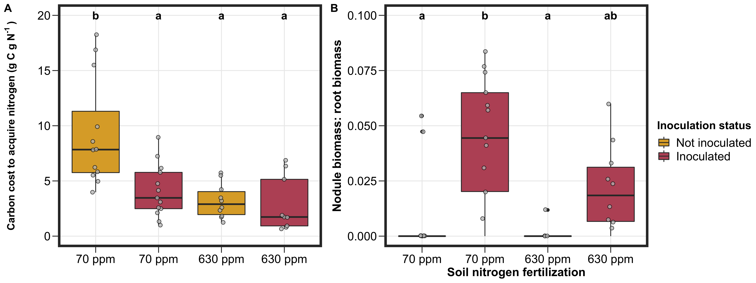

Slide 24
Soil nitrogen availability generally decreased carbon costs to acquire nitrogen regardless of inoculation status

Slide 25
Inoculation status generally decreased carbon costs to acquire nitrogen, but only under low soil nitrogen…

Slide 26
… a pattern driven by a shift toward direct uptake at high soil nitrogen

Slide 27
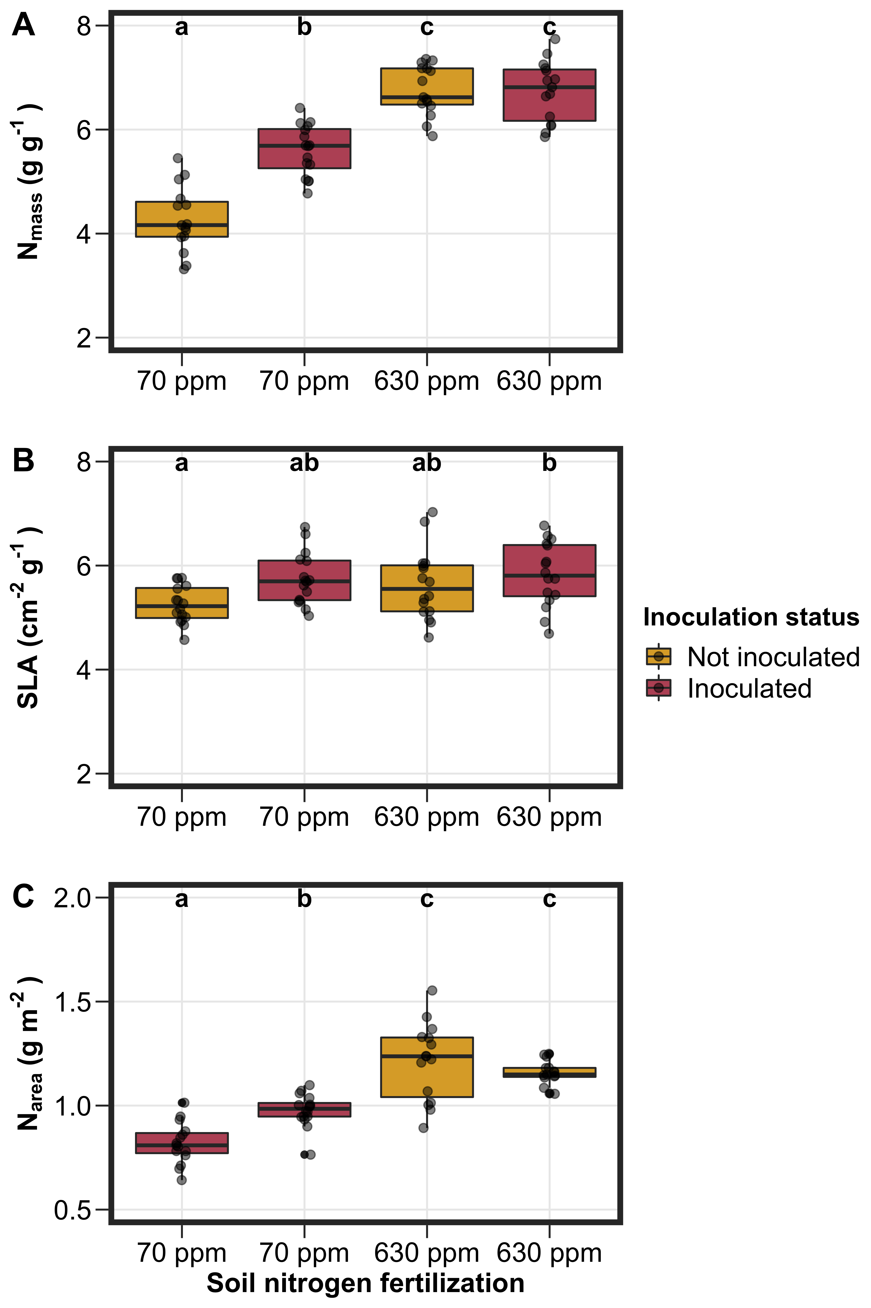
Leaf nitrogen allocation

Slide 28
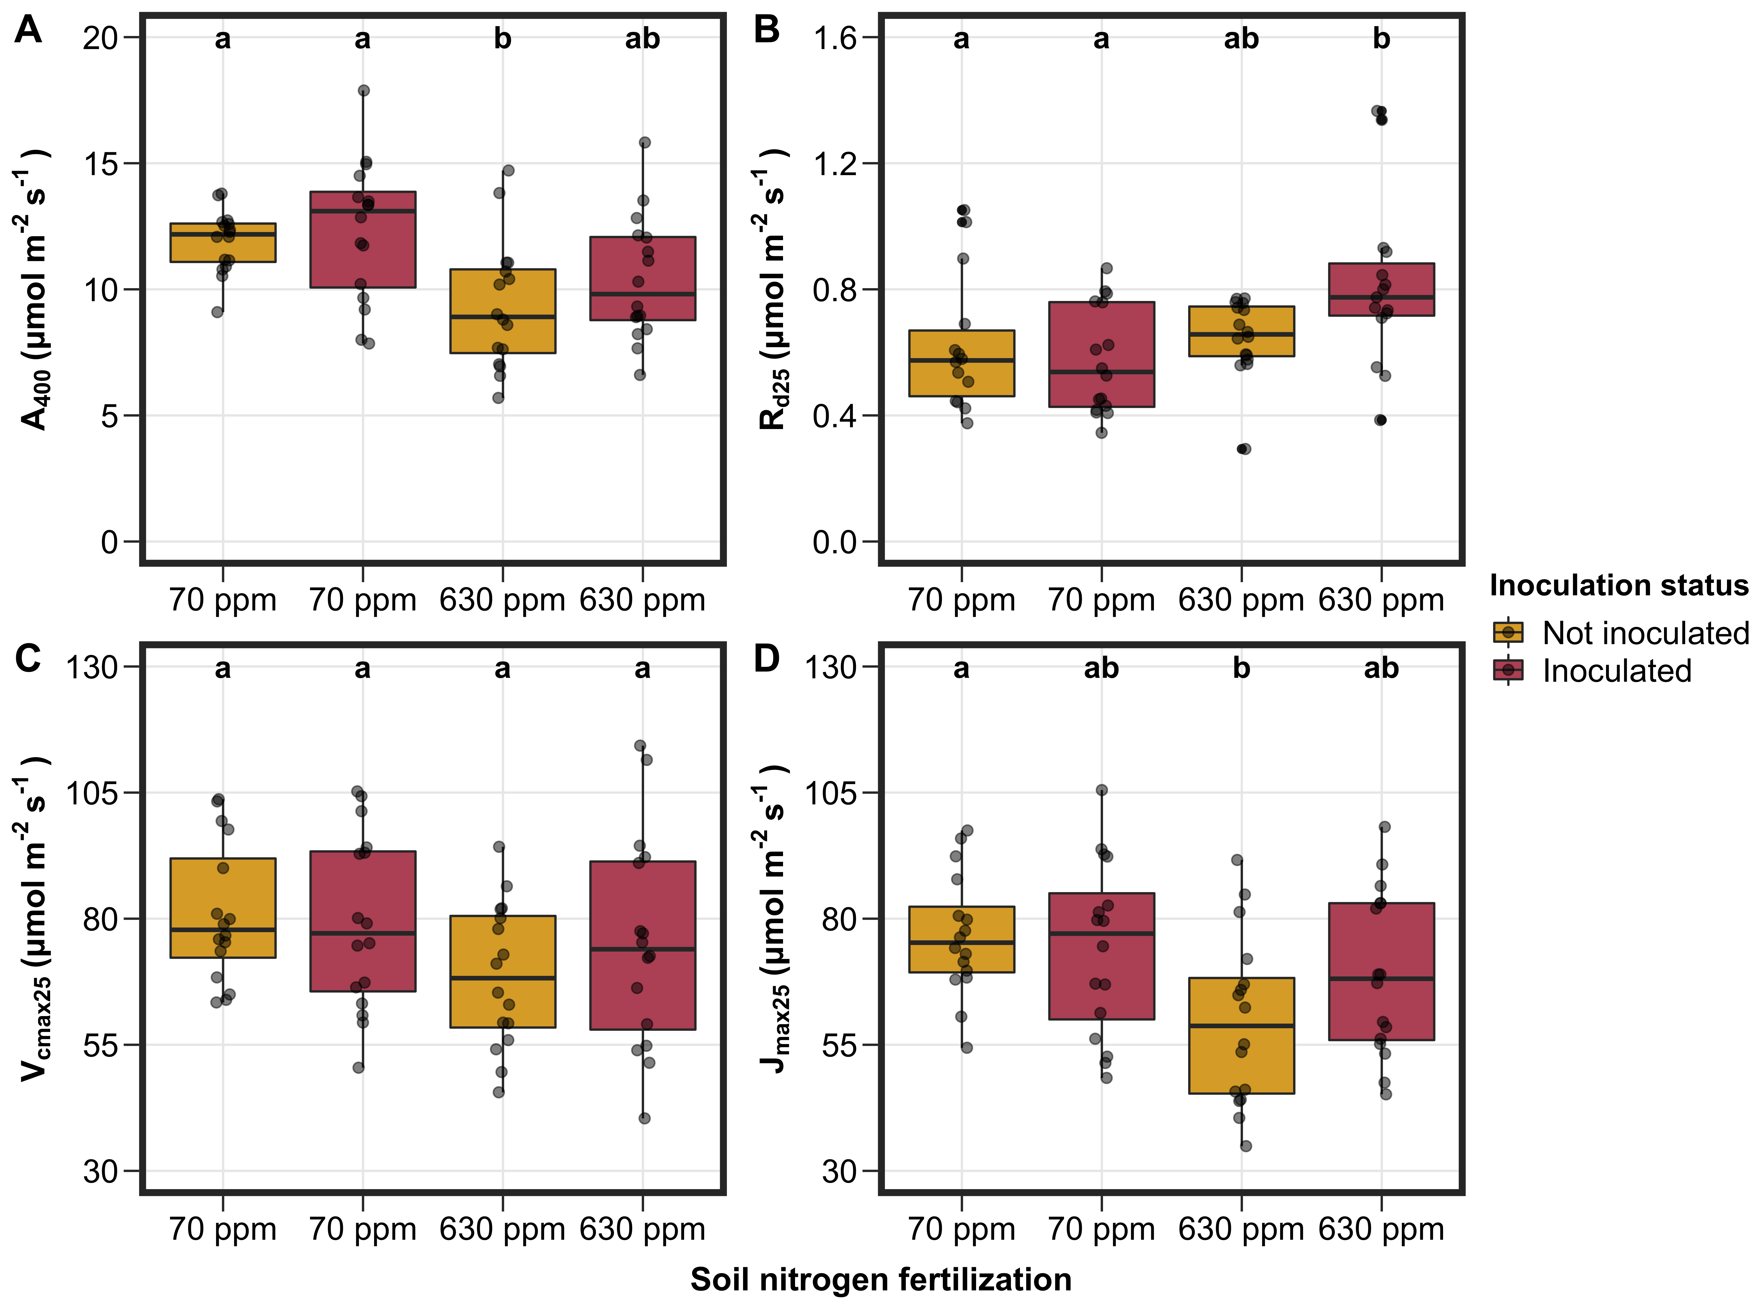
Leaf photosynthesis

Slide 29
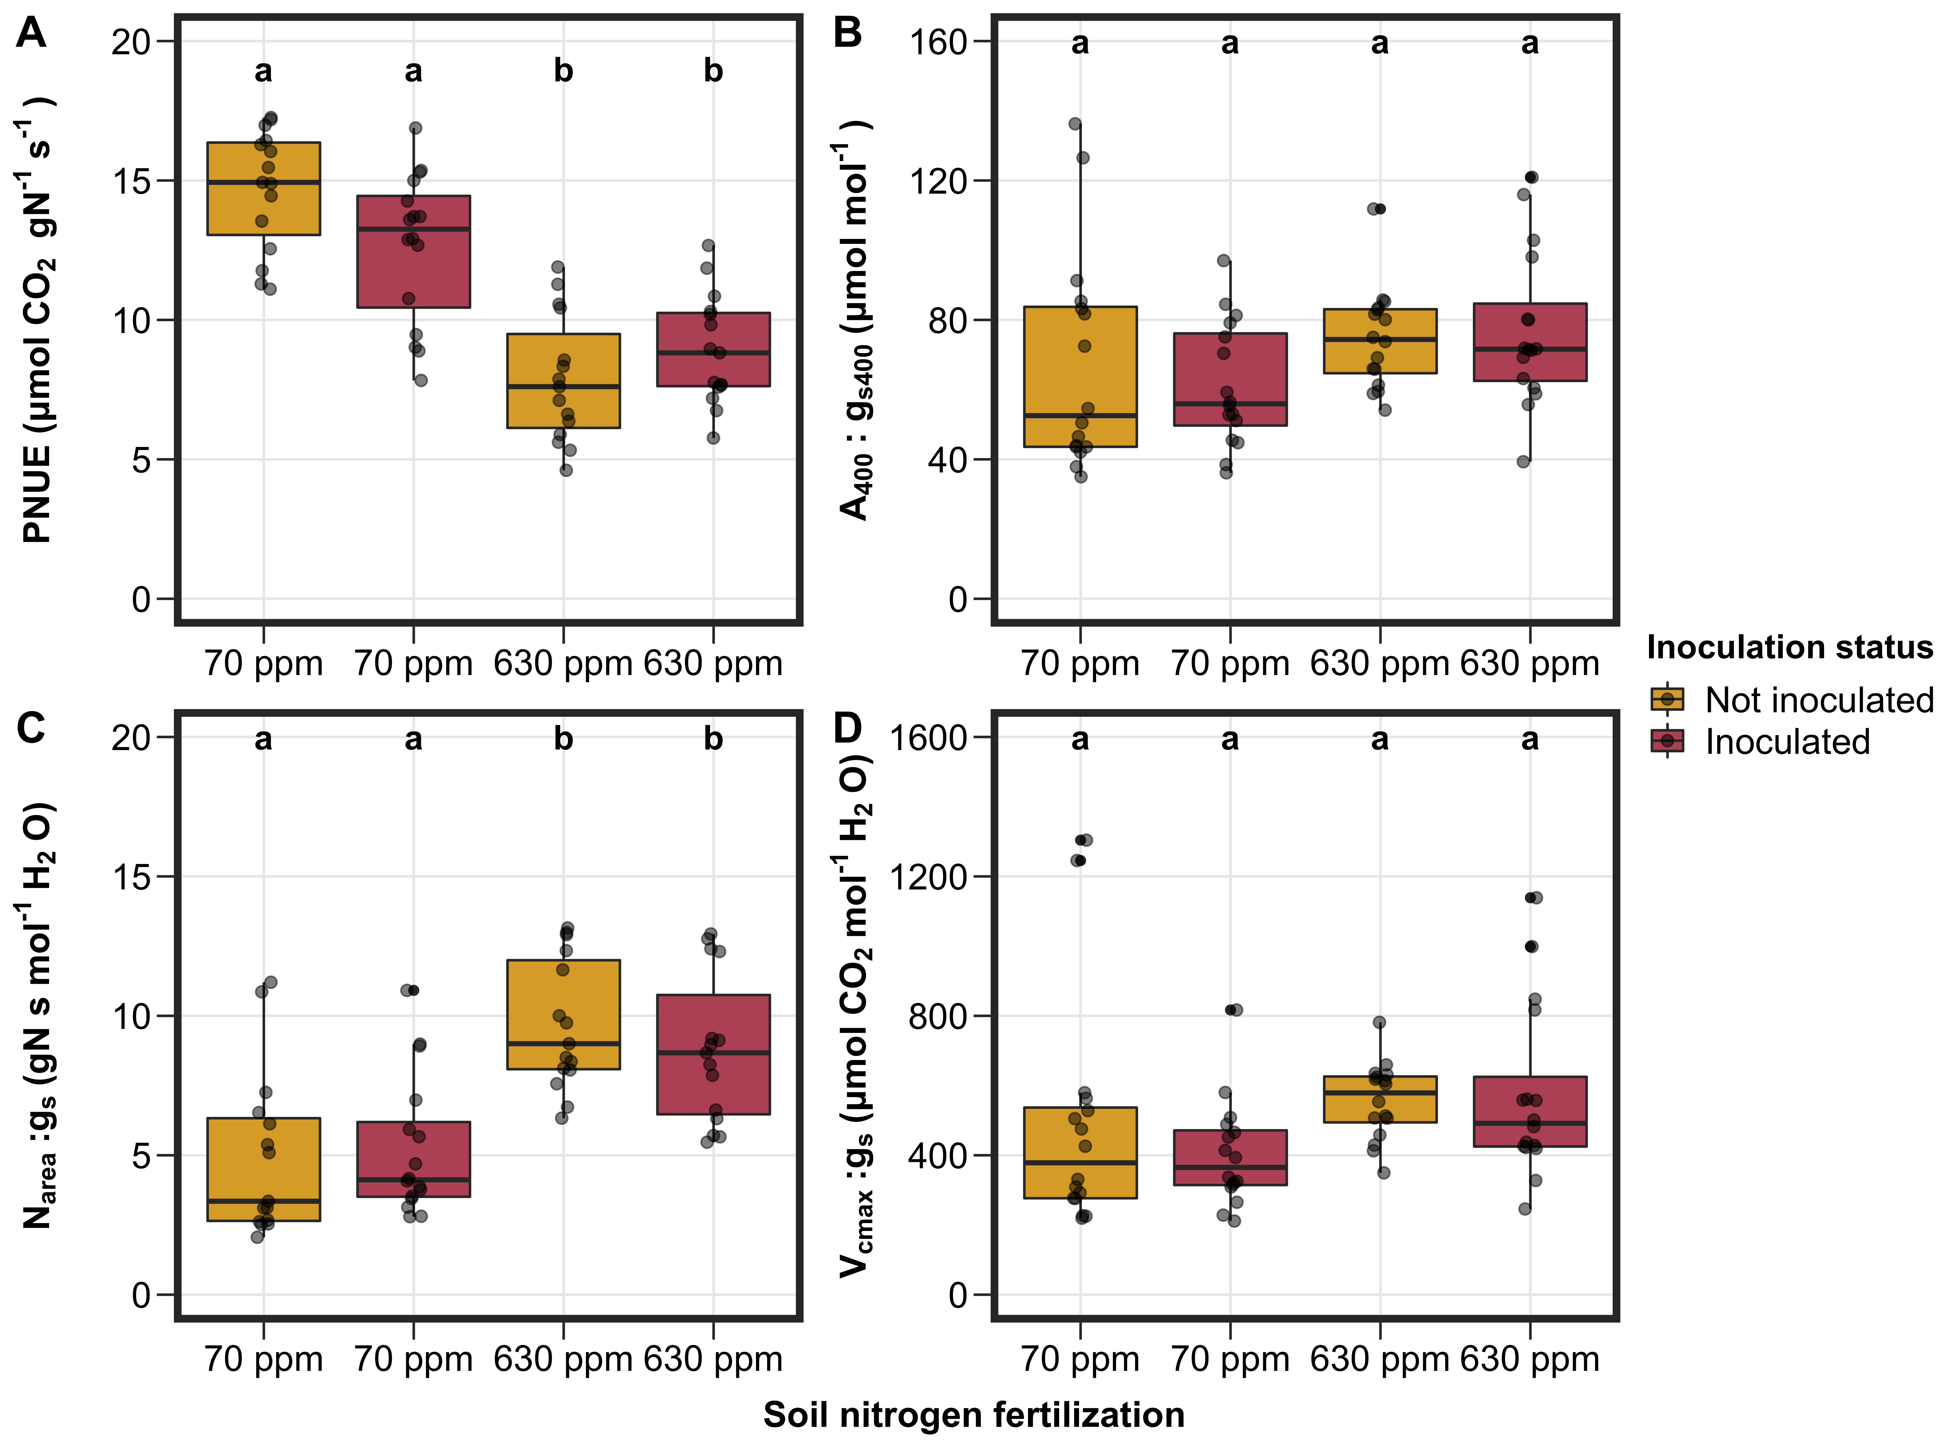
PNUE/WUE tradeoffs

Slide 30
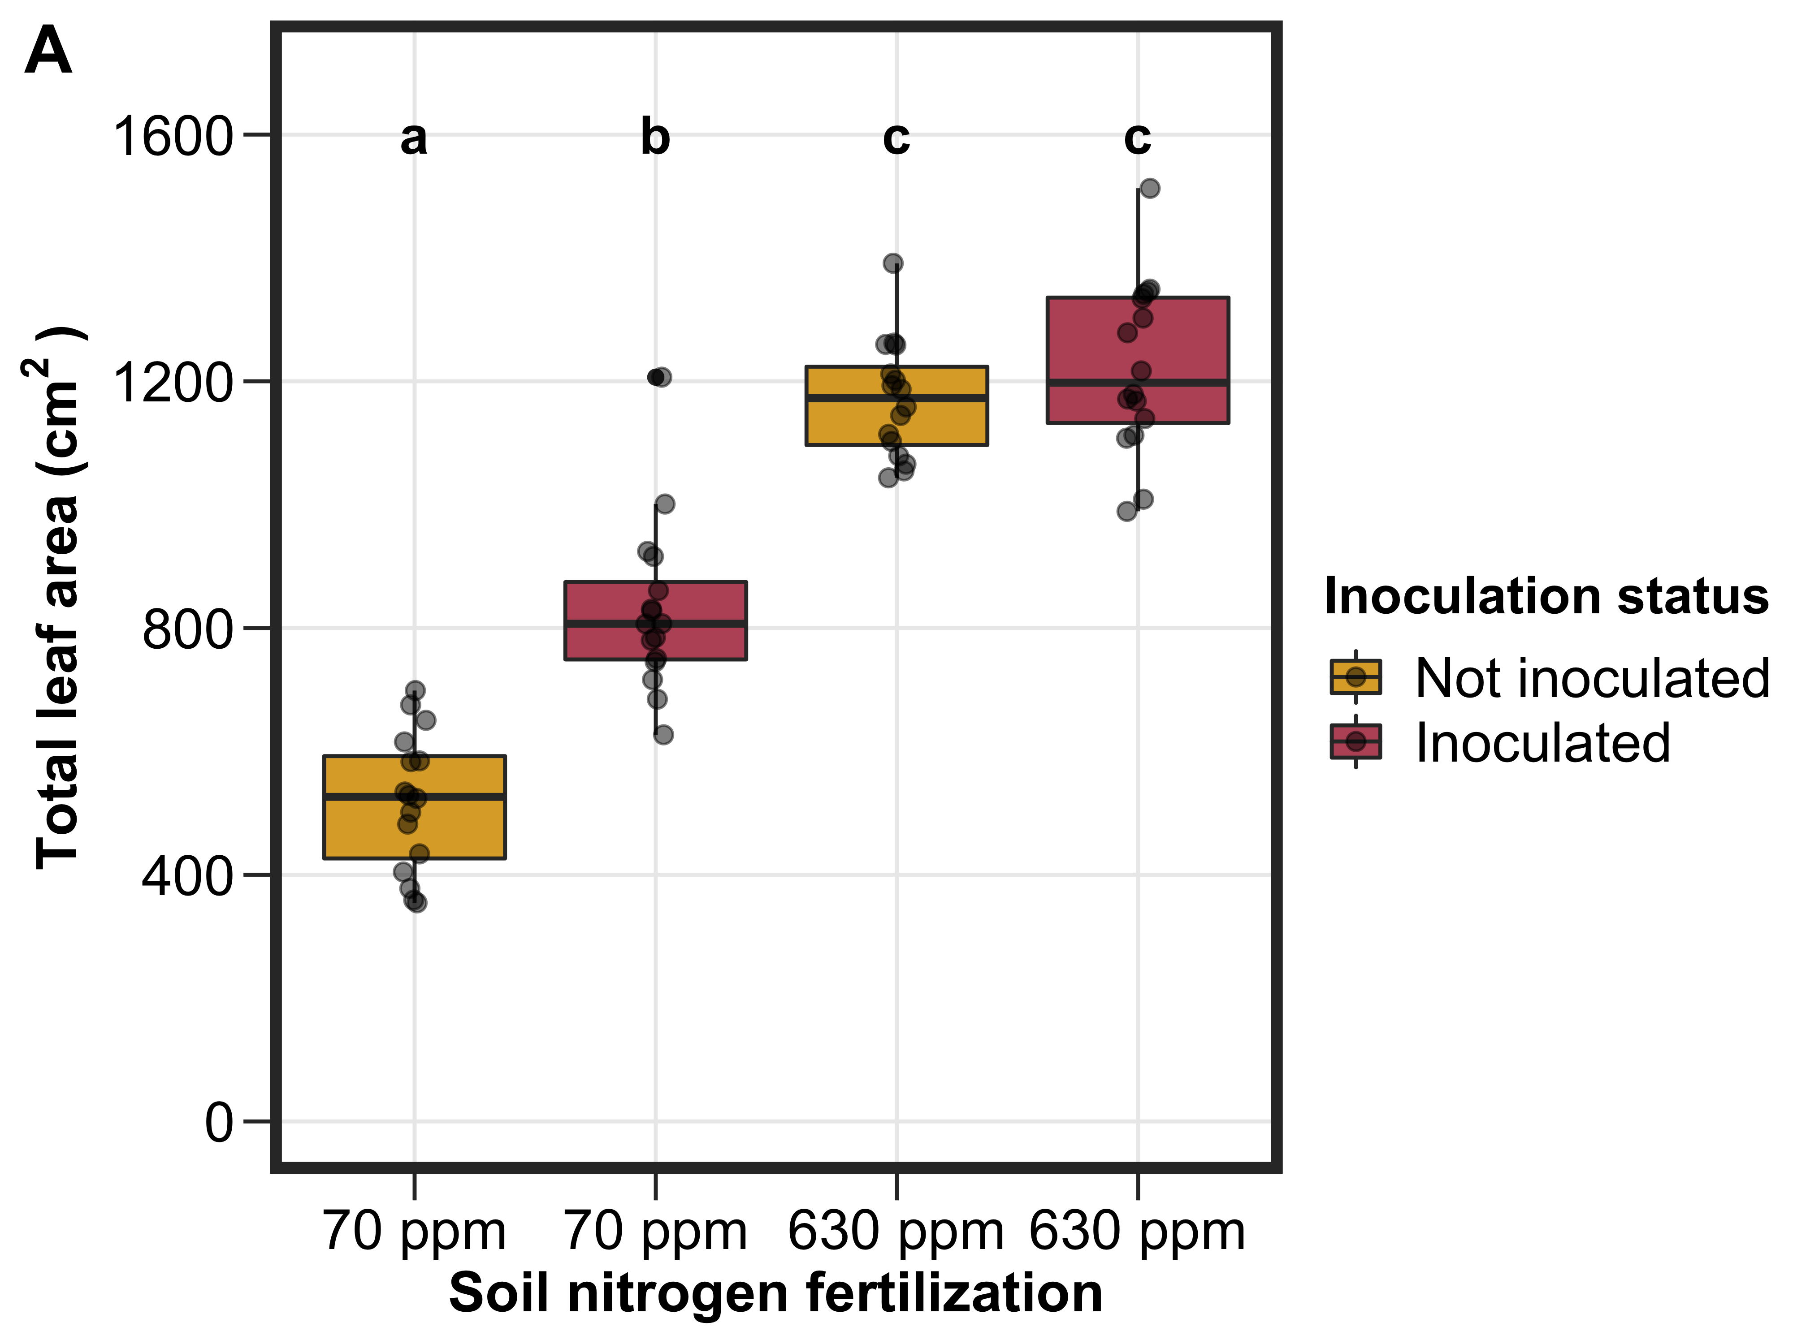
Inoculation status increases total leaf area, but only under low nitrogen. Soil nitrogen generally increases total leaf area

Slide 31
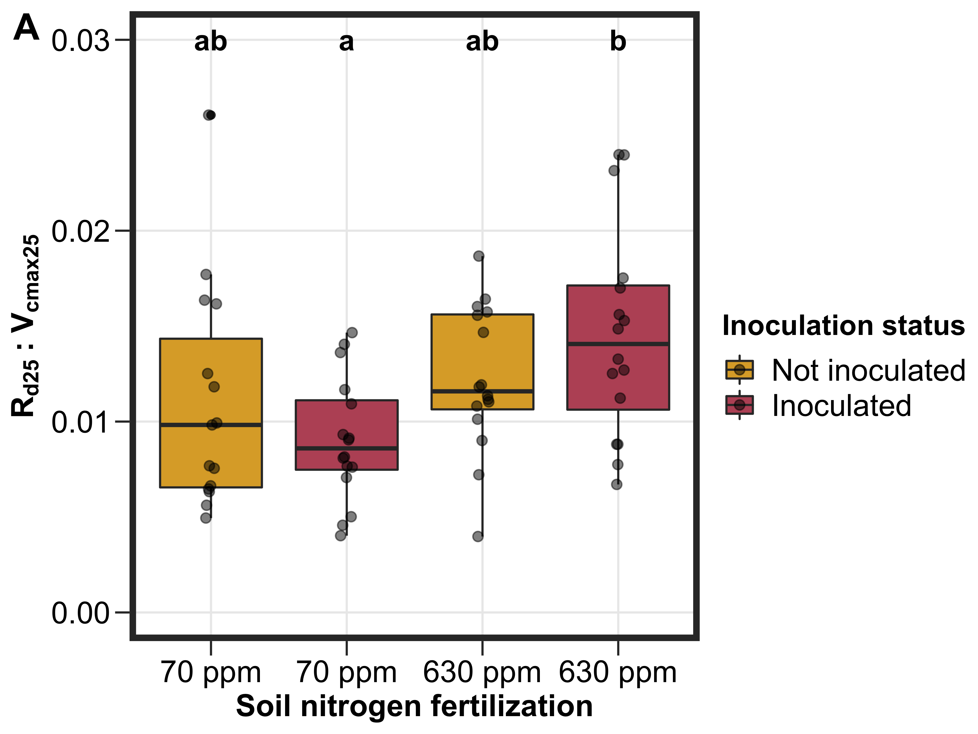
Rd:Vcmax
Notes:
Important for P-model

Slide 32
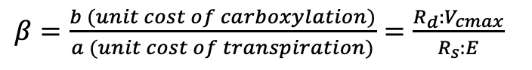
Rd:Vcmax
β = unit cost of acquiring and using resources
$β=\frac{b (unit cost of carboxylation)}{a (unit cost of transpiration)}=\frac{R_{d}:V_{cmax}}{R_{s}:E}$
Notes:
Important for P-model

Slide 33
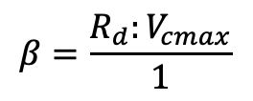
Rd:Vcmax
β = unit cost of acquiring and using resources
$β=\frac{b (unit cost of carboxylation)}{a (unit cost of transpiration)}=\frac{R_{d}:V_{cmax}}{R_{s}:E}$
If we assume a is constant across treatments:
$$β=\frac{R_{d}:V_{cmax}}{1}$$
Notes:
Important for P-model

Slide 34
Future Work
Bootstrap Rd:Vcmax values into P-model to construct model-data comparison?
At what point do nitrogen-fixing species shift from nitrogen fixation to direct uptake? Is this in agreement with Earth system models?
Upcoming CO₂ experiment with 9 soil nitrogen treatments will help tease this threshold apart
34
Notes:
We did not compare carbon costs to acquire nitrogen between species.
This is because cotton and soybean are not phylogenetically related and we are extremely limited in our ability to extrapolate these patterns to all nitrogen-fixing or non nitrogen-fixing species.
Therefore, future work will entail using a larger range of taxonomically related species to determine how generalizable these patterns are.
Additionally, this study was conducted over a short 5-week temporal scale, so there is also a need to evaluate these patterns across multiple spatiotemporal scales to determine the spatiotemporal range for which these patterns hold
Finally, we would love to evaluate the soil nitrogen threshold whereby nitrogen-fixing species shift from nitrogen fixation to direct uptake and to compare these results to patterns simulated by Earth system models.

